Slide 1
Self-Harm and Suicide Ideation On Reddit
By: Krutika, Prasad, Jonathan, Sheids

Slide 2
Abstract
Our Team analysed self-harm and suicide ideation on Reddit by scraping the data from the r/suicideWatch subreddit, focusing on the Emotional analysis of user behavior.
This Project leverages prompt-based feature extraction using large language models (LLMs) to capture variables based on the scientific instruments.
We investigate whether users' emotional states change over time based on their engagement with coping mechanisms and treatment interventions.
Our findings show that both coping mechanisms and treatments are associated with meaningful changes in emotional patterns over time.

Slide 3
Objective
To extract emotion dynamics using LLM-based prompts and quantify changes like increase emotional ratios and instability.
To explore demographic differences in suicide ideation and emotional response using gender and age group segmentation.
To assess whether frequent emotional fluctuations (instability) are linked to specific mental health traits.
To analyze how users' emotions change over time based on their use of coping mechanisms and treatment interventions.
To map users as emotionally improved or declined based on longitudinal emotion trends

Slide 4
Sources
Reddit data from Academic Torrents
Time frame of dataset 01/01/22 – 12/31/24
Features created based on Scientific Instruments
The Columbia-Suicide Severity Rating Scale (C-SSRS)
Self-Injurious Thoughts and Behaviors Interview (SITBI)
Diagnostic and Statistical Manual of Mental Disorders (DSM-V)
LLM Used- Google Gemini
Roberta based Emotional Score

Slide 5
Dataset Preparation
Filtered the dataset to retain only posts and comments from the years 2022 to 2024 to ensure temporal relevance.
Cleaned the data by removing non-essential elements such as hyperlinks, HTML tags, and other metadata to improve clarity and focus.
Organized the dataset by grouping posts and corresponding comments by user to construct coherent, thread-based conversational structures.
Utilized the user-threaded dataset to extract structured features using prompt-based queries on a Large Language Model (LLM).

Slide 6
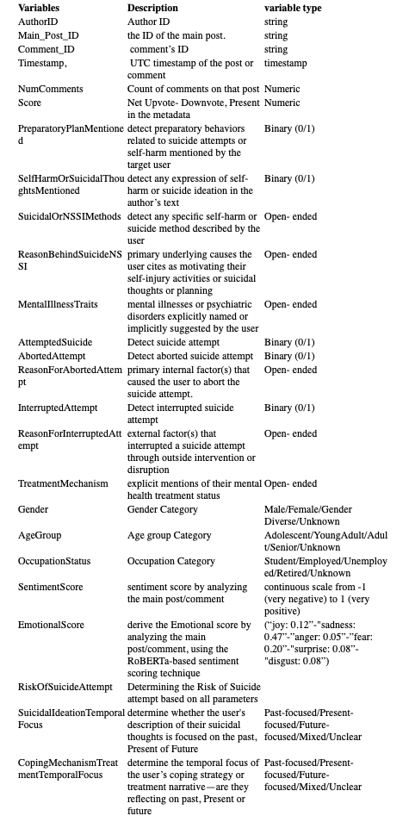
Feature List
Score: Dependent
Rest of them : Independent

Slide 7
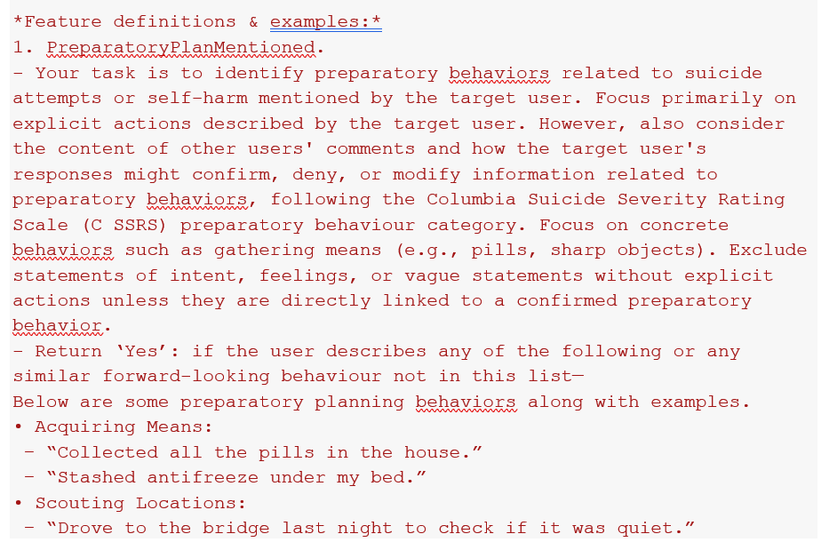
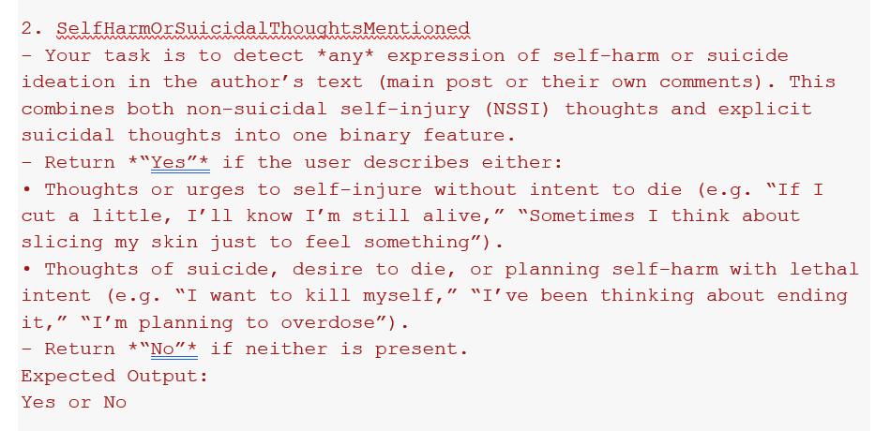
Prompt For Feature Extraction
We have used prompts like above examples ro extract each feature from the dataset

Slide 8
Dataset
363256
Dataset Cleaning
We extracted features from every post and comment into individual CSV rows, then aggregated those rows by user.
Unique users before cleaning- 1,40,115
Number of rows before cleaning- 363258
We dropped rows for which Emotional Score, Timestamp value were null
We dropped the author with blank name or with #Name error
We dropped rows for which half of the features were not extracted correctly
Unique user after Cleaning- 84,798
Number of rows after cleaning - 225,185

Slide 9
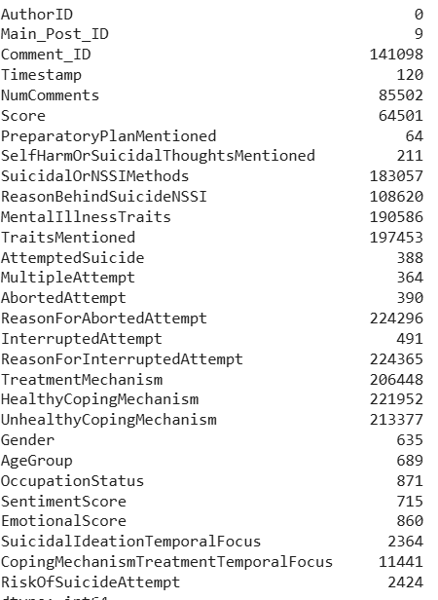
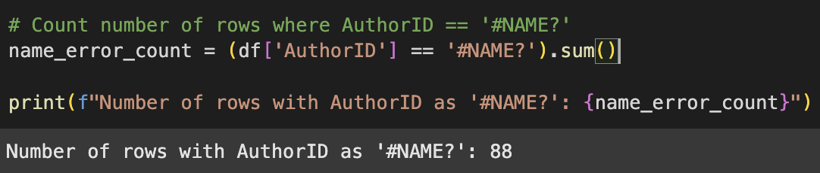
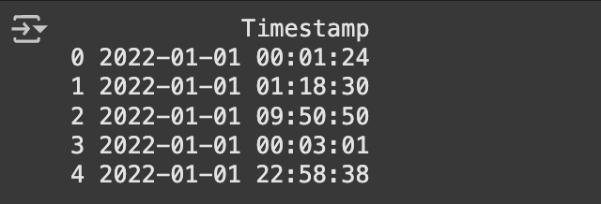
Data Cleaning
We removed null values for Emotional Score variable and for other variable we substitute it with ‘None’ keyword
Changed the Timestamp format
One –hot encoded the categorical variables

Slide 10
Exploratory Data Analysis

Slide 11
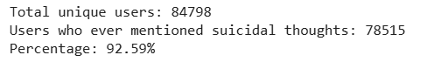
How many users have ever mentioned suicidal or NSSI thoughts?
Out of 84,798 total users, 78,515 (≈92.6%) mentioned self-harm or suicidal thoughts at least once.

Slide 12


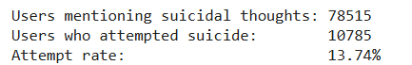
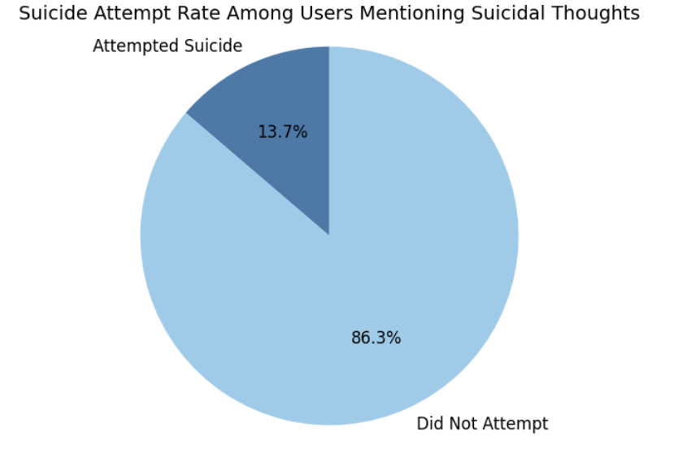



How many attempted at least once?

Slide 13
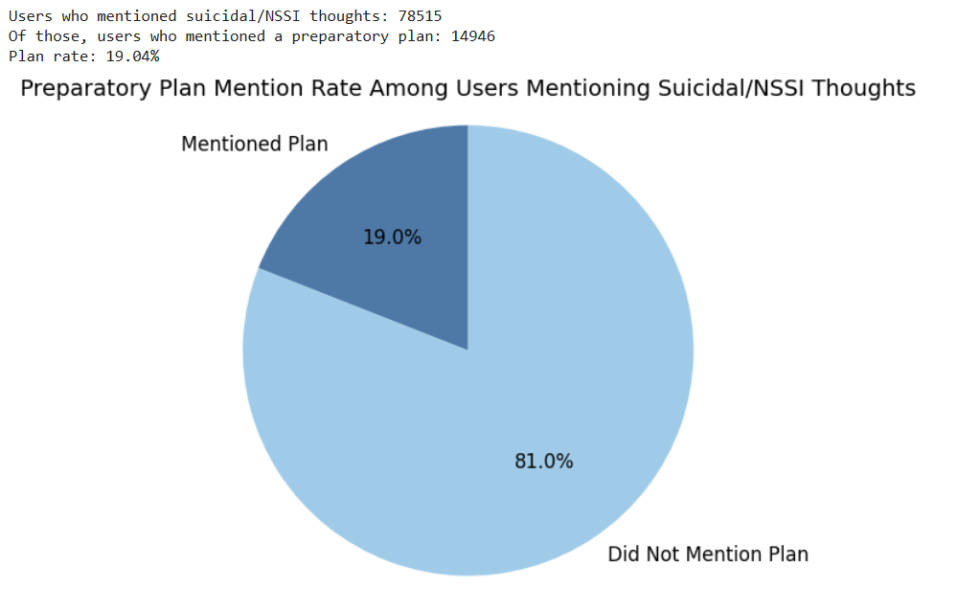
How many mentioned preparatory behavior?

Slide 14
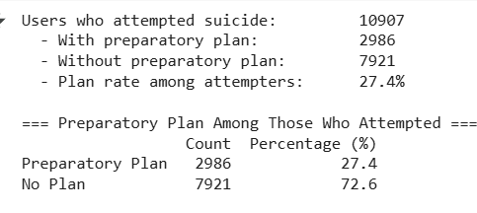
Out of users who attempted suicide, how many have a preparatory plan?
Only about one in four users who attempted suicide (27.4%) had mentioned a preparatory plan beforehand, while nearly three-quarters (72.6%) did so without any indicated planning.

Slide 15
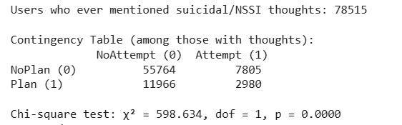
Is planning behaviour significantly associated with attempts?
No‐plan group: 7,805 of 63,569 users (~12.3%) went on to attempt suicide
Plan group: 2,980 of 14,946 users (~19.9%) went on to attempt suicide
χ²(1) = 598.634, p < .0001 ⇒ reject H₀ (planning and attempt are independent)
Conclusion: preparatory planning is significantly associated with an increased risk of later suicide attempt

Slide 16
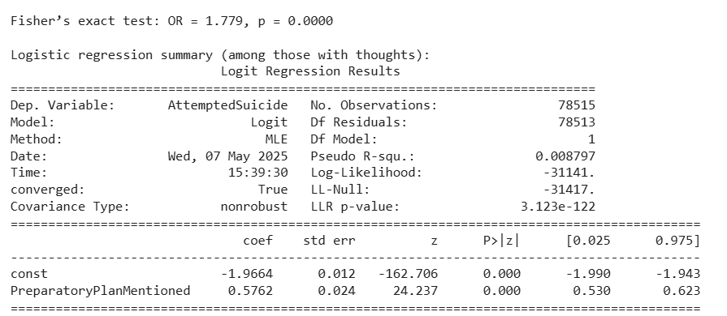
Is planning behaviour significantly associated with attempts?
Odds Ratio (OR) of 1.78 means that among those with suicidal/NSSI thoughts, the odds of attempting suicide are about 78% higher if you reported having a preparatory plan vs. not. Fisher’s p-value < .0001 again confirms this association is highly unlikely to be due to chance
With a Pseudo R² of only 0.009, planning alone is far from a complete risk model—it’s an important risk marker, but many other factors contribute to who will attempt
.

Slide 17
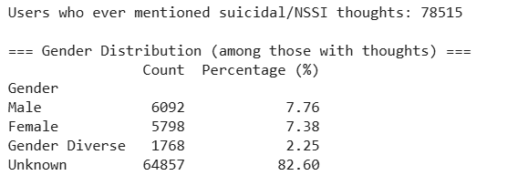
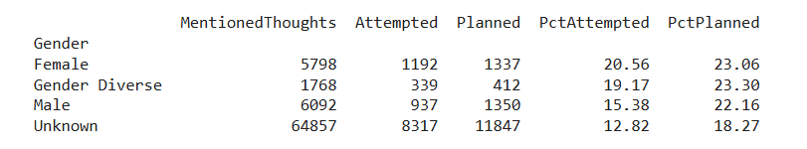
Suicide Preparatory Planning Across Gender
In every group, a higher share reported planning than attempting
Gender‐diverse users show the highest propensity to plan (23.3%), though their attempt rate (19.2%) trails females (20.0%).
Females have the highest attempt rate despite lower planning than gender‐diverse and male users.

Slide 18
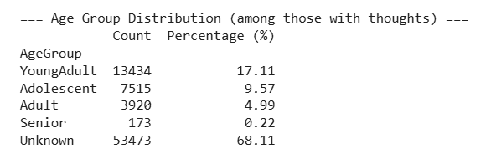
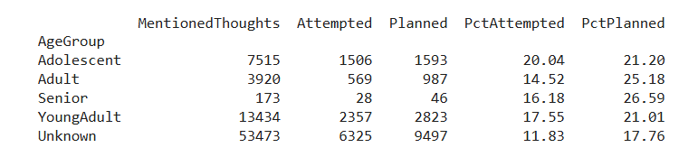
Suicide Preparatory Planning Across Age Groups
Age Groups
Adolescents- 11-17 years
Young Adults- 18-30 Years
Adults- 31-50 years
Seniors- 50 + years
Every age band shows planning rates above attempt rates
Adults and seniors show the highest propensity to plan, though the senior sample is very small
Adolescents have the highest attempt rate among sizeable groups

Slide 19
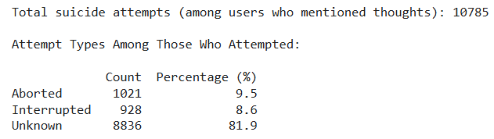
Aborted and Interrupted Attempts Out of Total Attempts

Slide 20
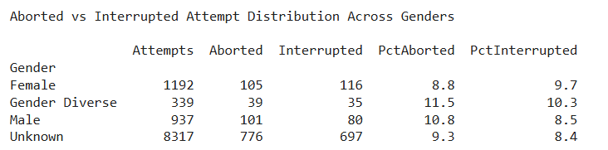
Aborted and Interrupted Attempts Pattern Across Gender
Gender‐diverse: 11.5% of attempts were self-aborted (highest)
Gender‐diverse: 10.3% of attempts were interrupted (highest)
Attempt dynamics differ by gender: gender‐diverse individuals more frequently call off their own attempts, and their attempts externally interrupted.

Slide 21
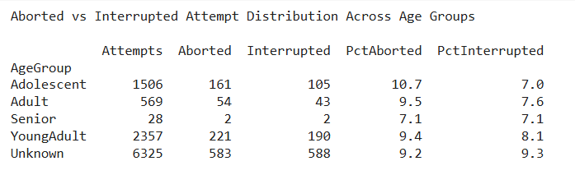
Aborted and Interrupted Attempts Pattern Across Age Groups
Adolescents most likely to self-abort attempts among sizeable groups

Slide 22
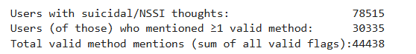
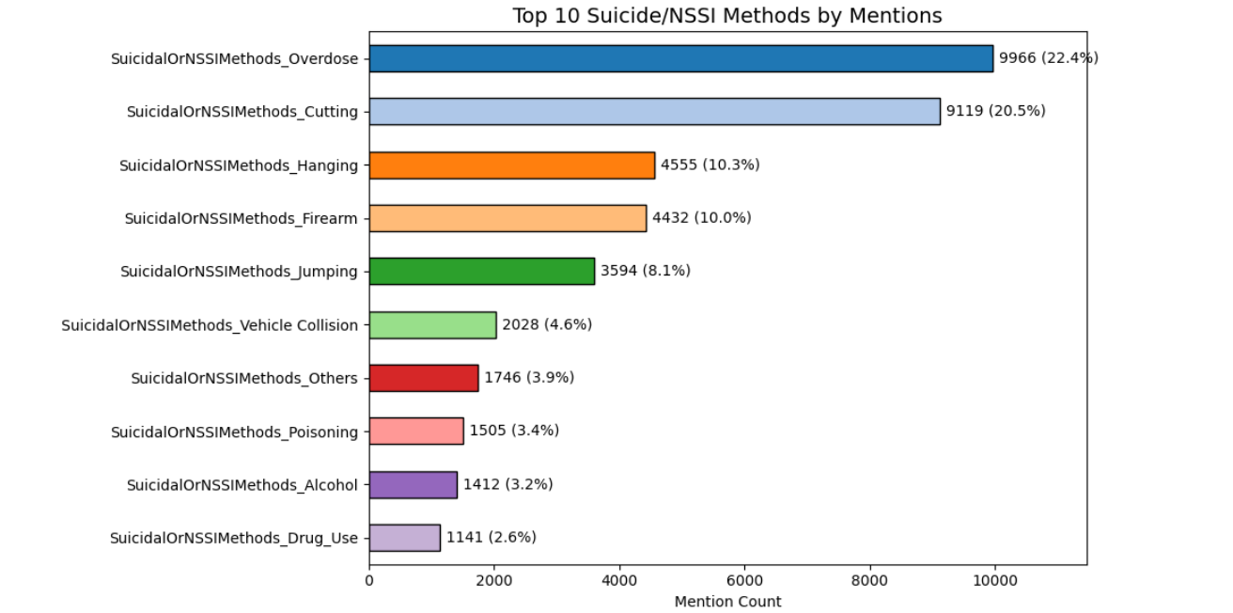
Dominant Suicidal or NSSI Methods
User scope: 78,515 users expressed suicidal/NSSI thoughts; 30,335 (38.6%) of them named ≥1 specific method (total methods mentions =44,438).
Dominant methods: Overdose (22.4%) and cutting (20.5%) together comprise ~43% of all method mentions.
Lethal‐intent methods: Hanging (10.3%), firearms (10%) and jumping (8.1%) account for a further ~28%.

Slide 23
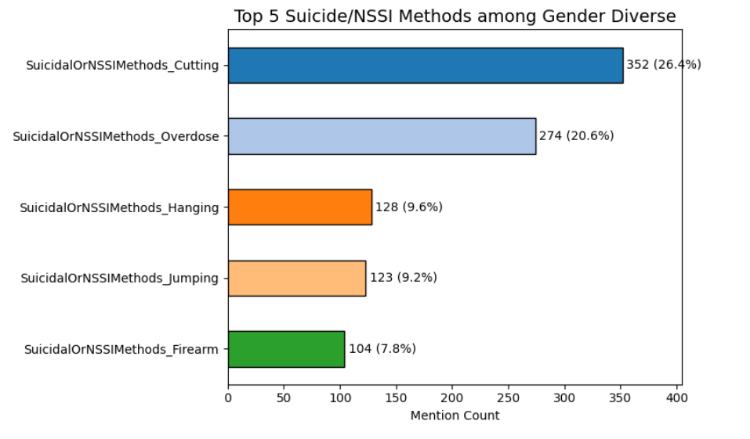
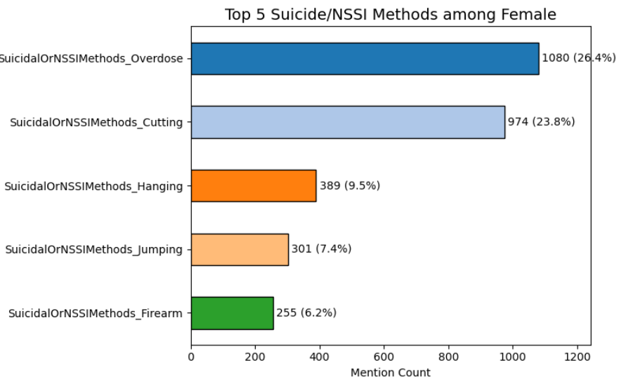
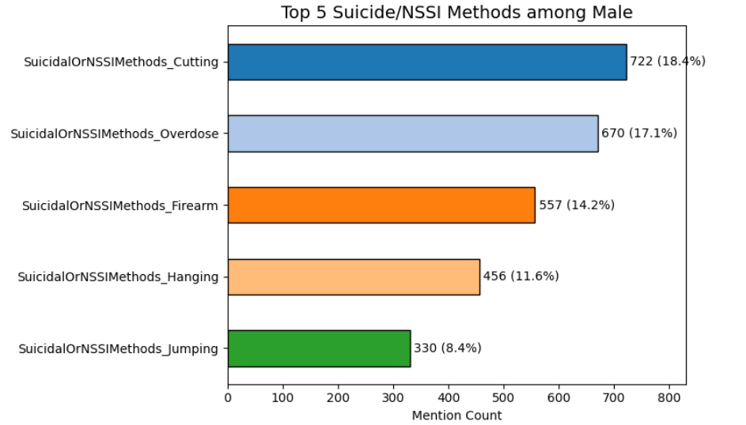
Suicidal or NSSI methods Across Gender
while cutting and overdose are universal leading methods, males show a stronger firearm component, and gender-diverse users report relatively more jumping;

Slide 24
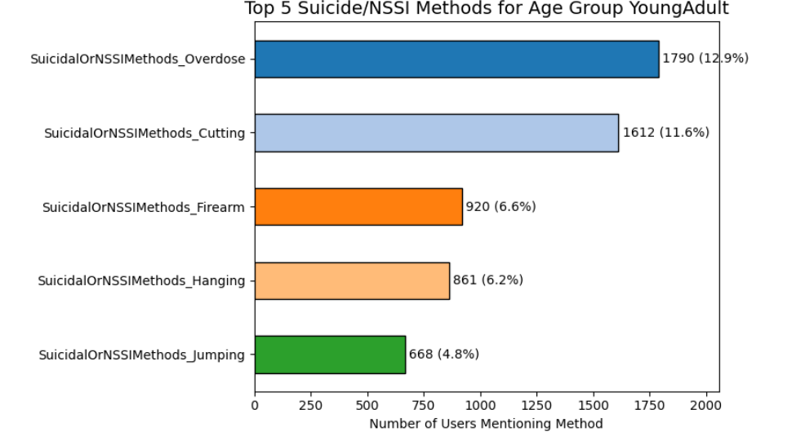
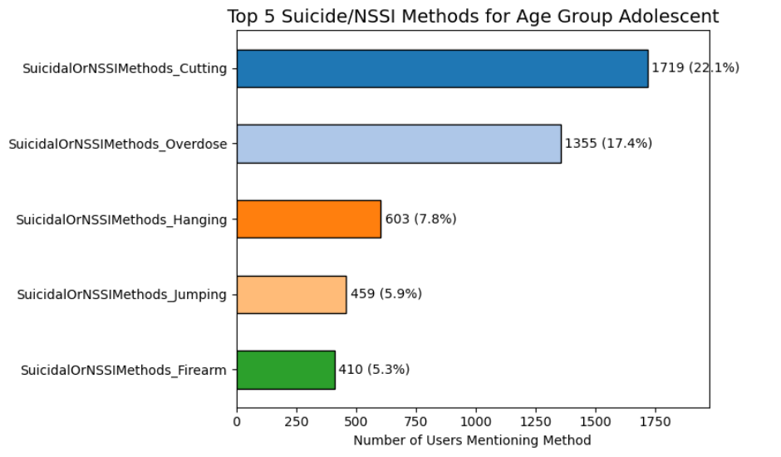
Suicidal or NSSI Methods Across Age Groups
Cutting peaks in adolescence
Overdose becomes the dominant method in young adulthood and beyond
Jumping appears mainly among adolescents and young adults

Slide 25
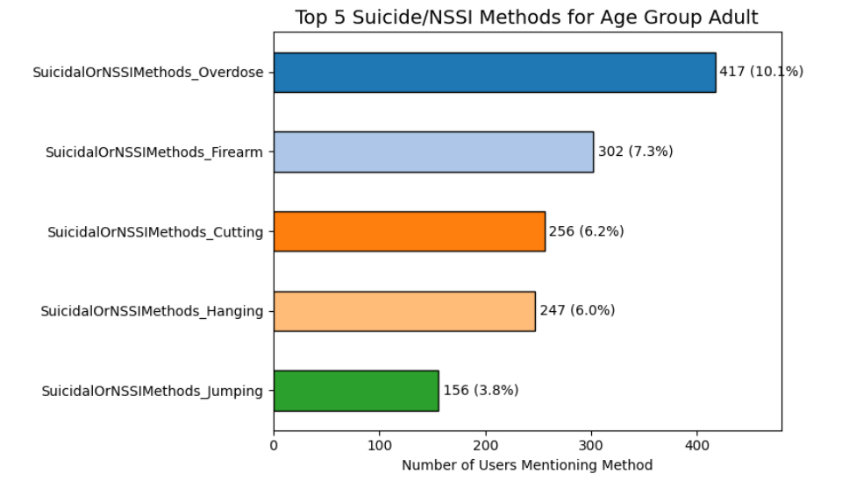
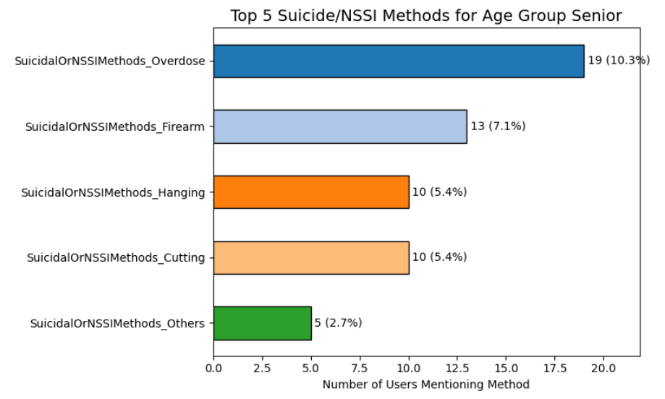
Suicidal or NSSI Methods Across Age Groups
Overdose becomes the dominant method
Firearms gain relative prominence in adults

Slide 26
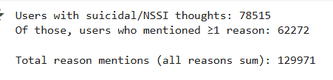
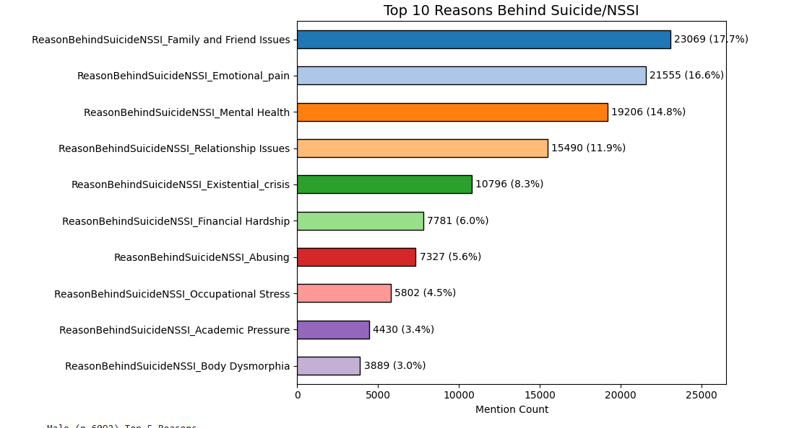
Dominant Reasons Behind Suicidal Thoughts
62,272 out of 78,515 users (≈80%) named at least one reason
Top two drivers (~34%):
Family & friend problems (17.7%)
Emotional pain (16.6%)

Slide 27
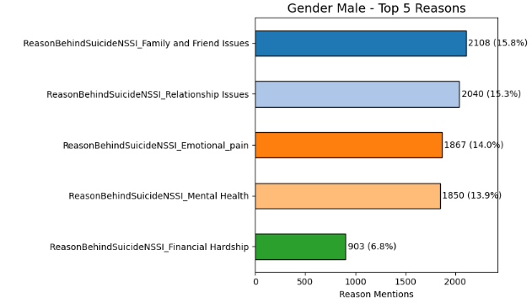
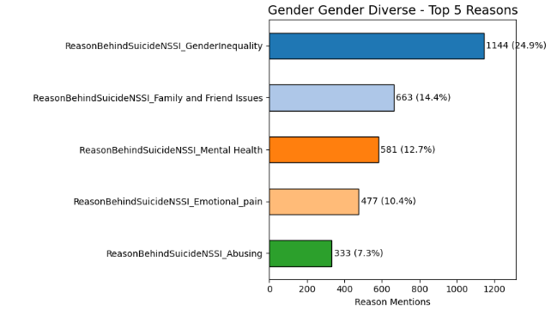
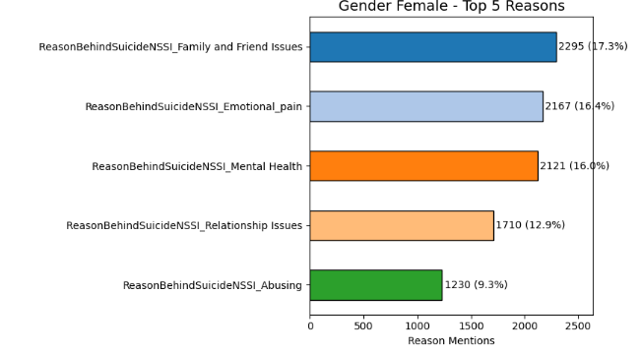
Reason Behind Suicide Across Gender
Family & Friend issues: leading driver across genders; it’s the #1 reason for females (17.3%) and males (15.8%), and #2 for gender-diverse users (14.4%).
Gender-diverse users uniquely cite gender inequality
Emotional pain is more prevalent for females (16.4%) than males (14.0%) or gender-diverse (10.4%).

Slide 28
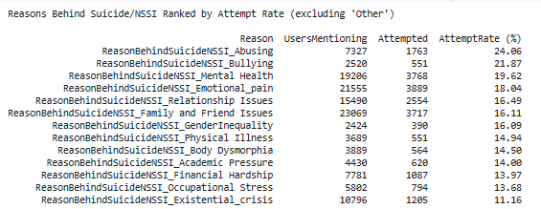
Reasons Behind Suicide/NSSI Ranked by Attempt Rate
Abuse has the highest attempt rate (24%) marking it a disproportionately high‐risk trigger.
Bullying shows the next‐highest risk (21%), though it’s mentioned by just 2520 users
Family and Friend issues is the most common reason (23069 users) with an 16.11% attempt rate, high prevalence and substantial risk.
Attempt Rate- User who attempted/user who mentioned the Reason

Slide 29
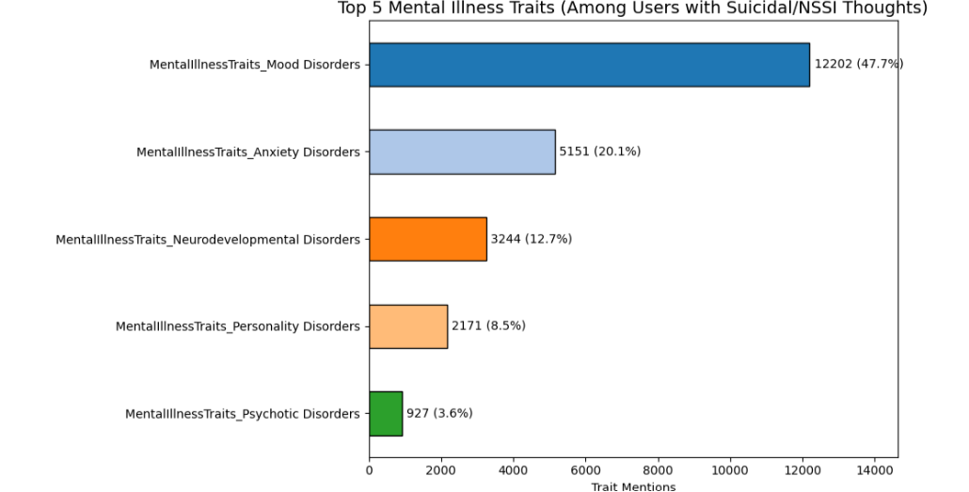
Dominant Mental Illness traits across all users
Here, we are using the DSM-5 instrument to categorize the Mental illness traits
Mood and anxiety disorders together represent over three-quarters (68%) of all mental-illness traits cited by users with suicidal/NSSI thoughts.
Mood Disorders
Anxiety Disorders
Obsessive-Compulsive and Related Disorders
Trauma and Stressor-Related Disorders
Psychotic Disorders
Eating Disorders
Personality Disorders
Neurodevelopmental Disorders
Substance-Related and Addictive Disorders
Somatic Symptom and Related Disorders
Sexual Dysfunctions
Sleep-Wake Disorders
Neurocognitive Disorders
Other Mental Health Disorders

Slide 30
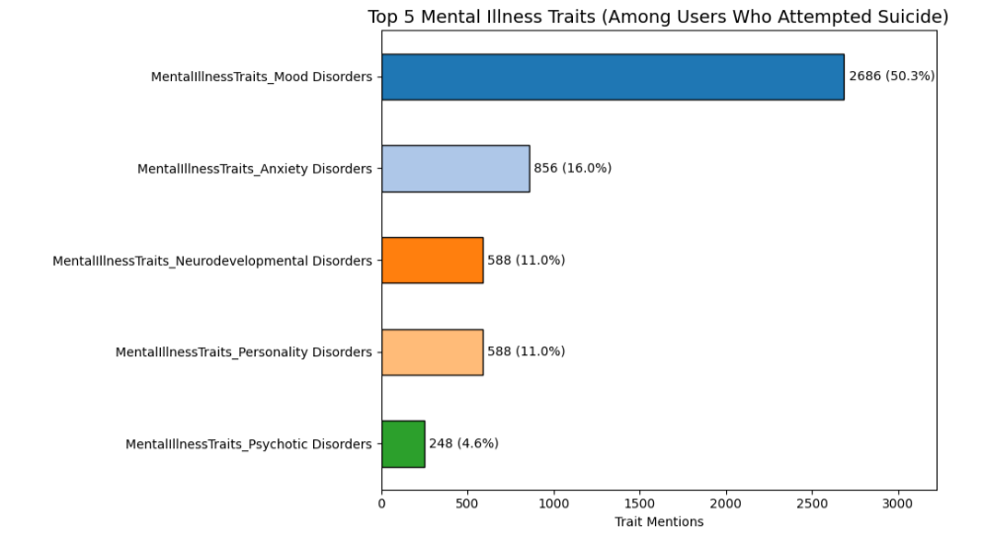
Dominant Mental Illness Traits Among Users Who Attempted Suicide
Mood disorders dominate among attempters, accounting for 50.3% of all trait mentions
Anxiety disorders are the next most cited, at 16.0% of mentions.

Slide 31
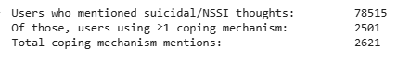
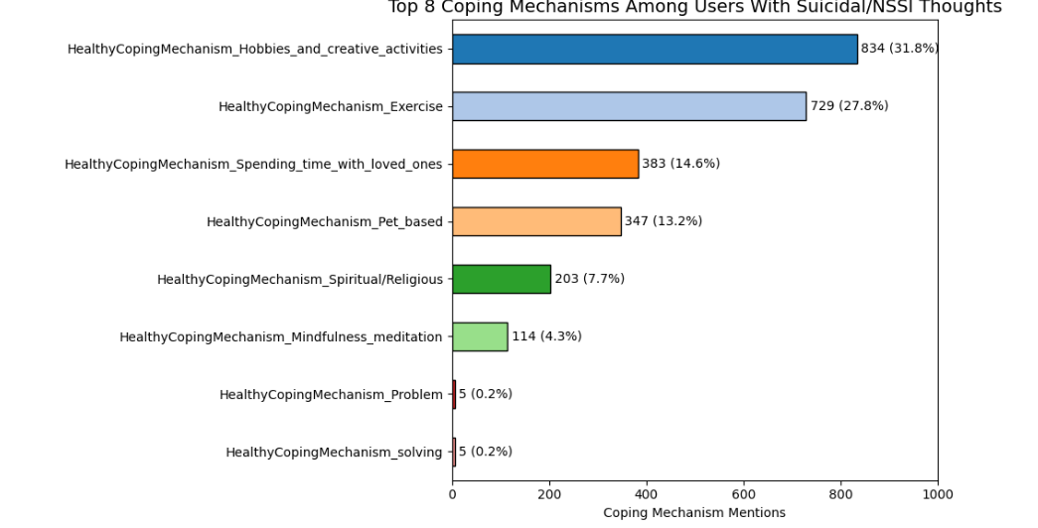
Healthy Coping Mechanisms Used
2,501 of 78,515 users reported at least one healthy coping mechanism
Hobbies and creative activities are the most used coping mechanism.

Slide 32
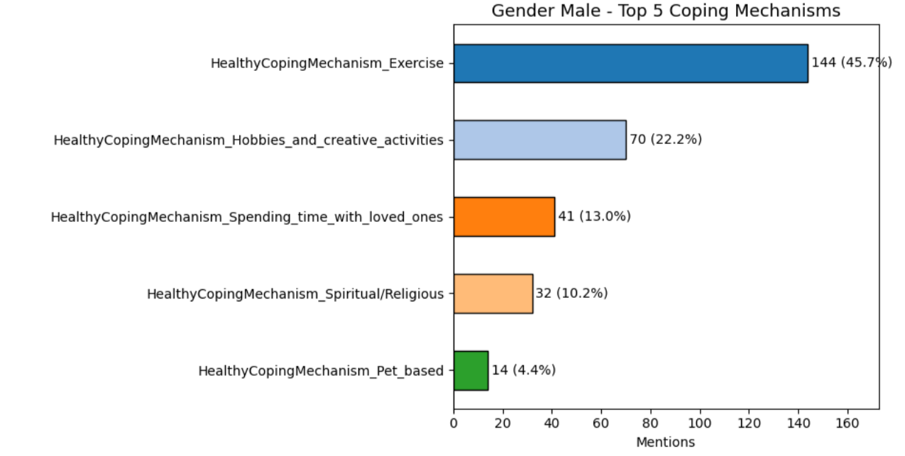
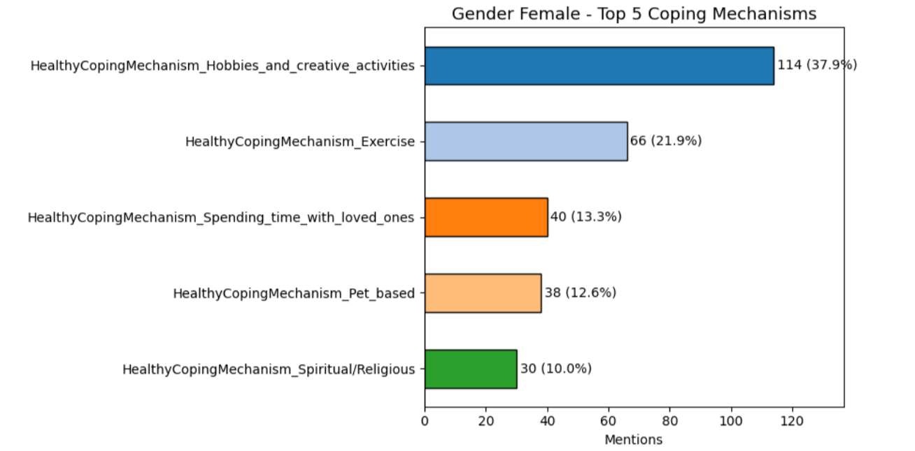
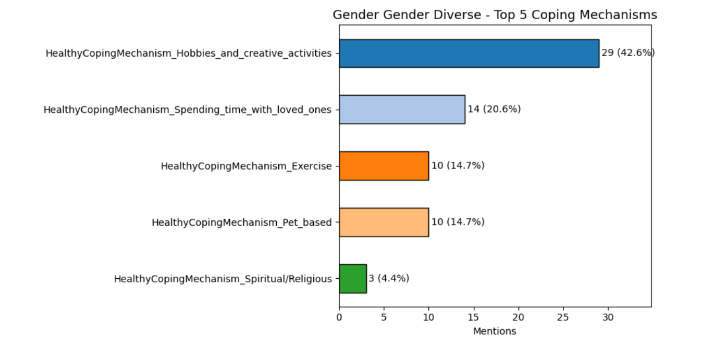
Coping Mechanisms Across Genders
Male users strongly lean toward physical coping (exercise), with less diversity in coping styles compared to female users.
Female users display a balanced coping strategy, combining creative, physical, emotional, and spiritual approaches.
Gender diverse individuals heavily favored creative outlets and emotional connections with loved ones. Spirituality appears less prevalent among this group.

Slide 33
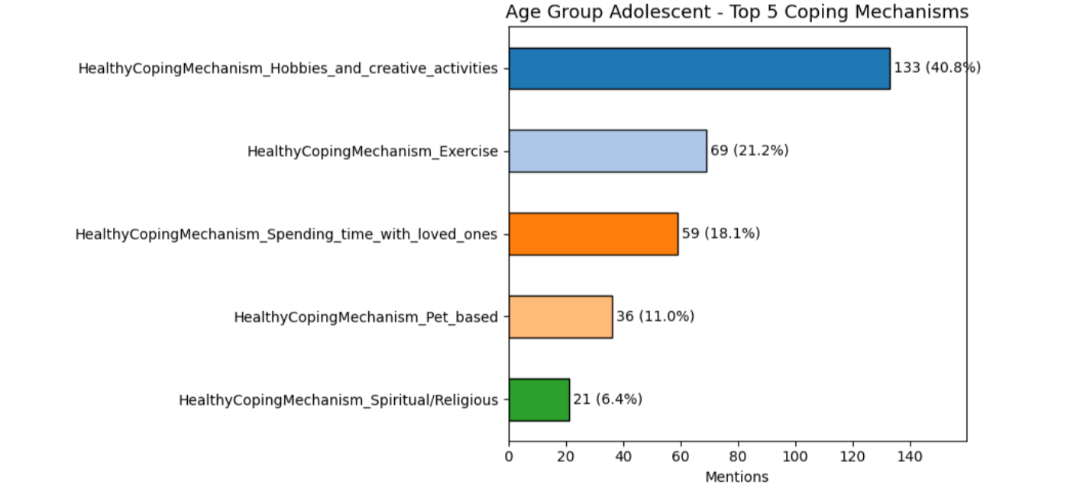
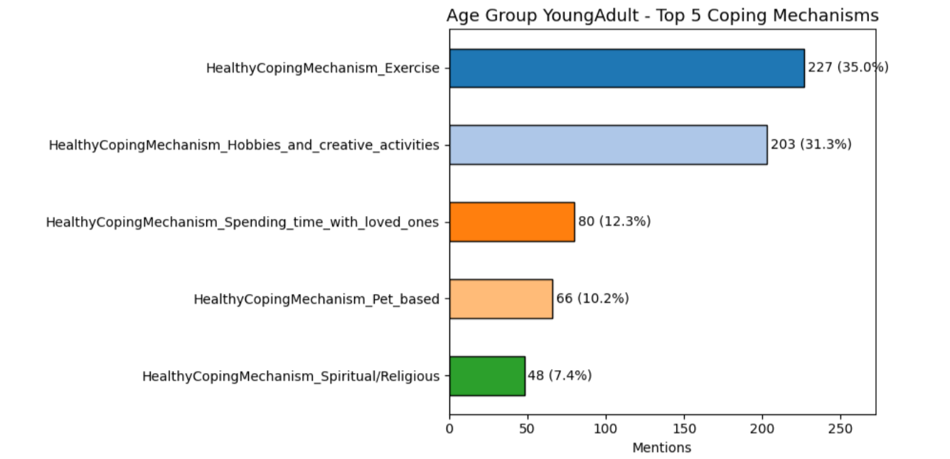
Coping Mechanism Across Age Group
Young Adults show the highest volume of coping strategies and prefer physically and creatively engaging methods. Their coping is relatively well-balanced across options.

Slide 34
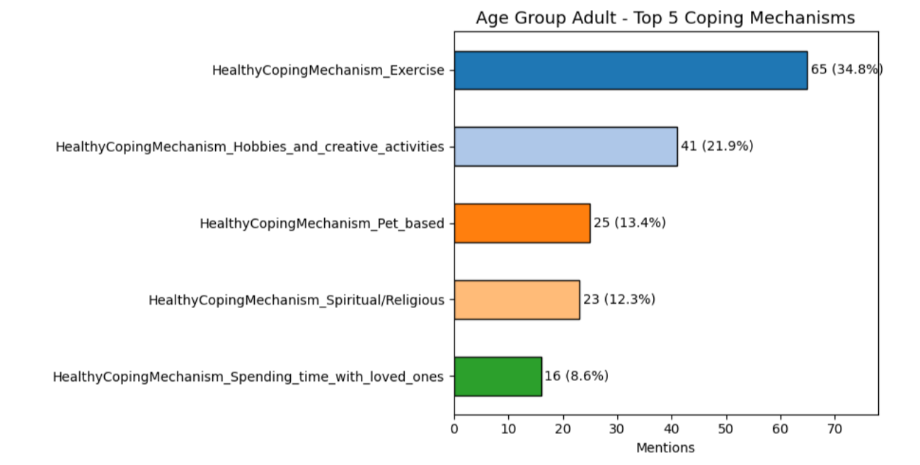
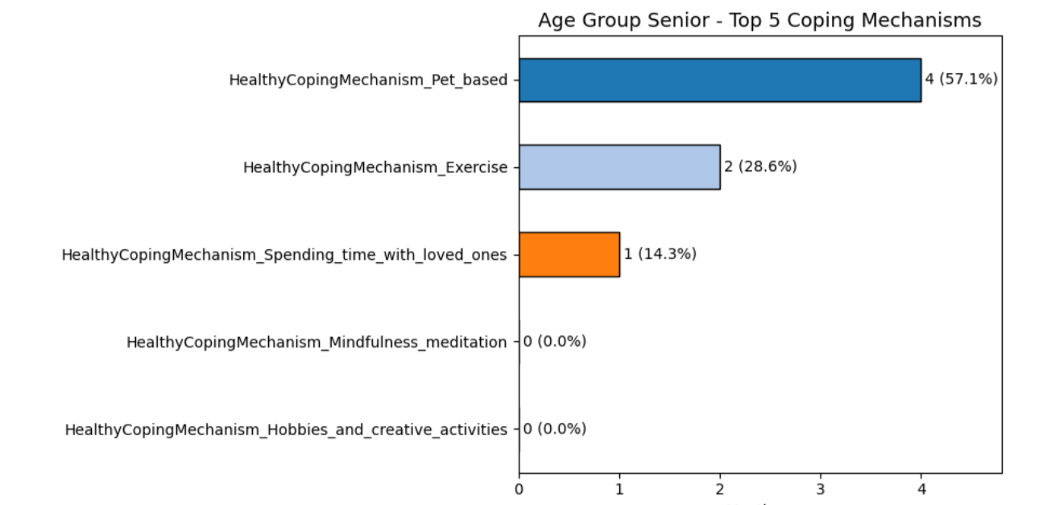
Coping mechanism across Age Group
Adults prioritize physical and solo activities. Emotional support (e.g., family, pets) plays a less significant role compared to younger groups.

Slide 35
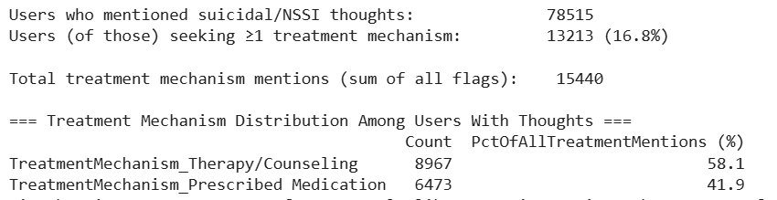
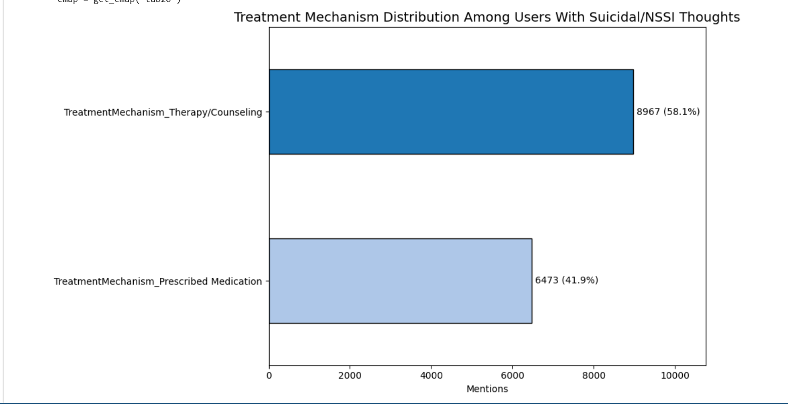
Users Seeking Treatment Mechanisms
13213 of 78515 ideators (16.8%) report seeking any formal treatment
Therapy/counseling dominates treatment mentions (58.1%)
While professional support (therapy or meds) does reach one in five users, the majority of ideators use neither adaptive coping nor formal treatment.

Slide 36
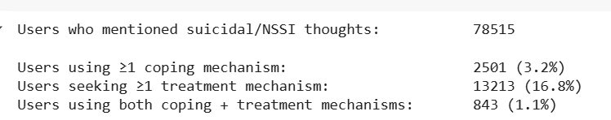
Users Seeking Treatment Mechanisms
Coping vs. treatment: only 3.2% use a coping mechanism, 16.8% seek treatment, but only 1.1% engage in both - suggesting many rely on one or the other

Slide 37
Regression Model -Key Drivers of Engagement
Score: Net Upvote –Downvote
Here we are finding out which variables are significant to generate higher score on the post
T- test result for Binary variables with Score

Slide 38
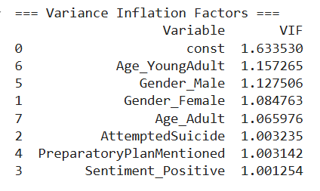

Regression Model- Key Drivers of Engagement
Pearson test for Numeric Variable Number
of Comments with Score
VIF Test Results
An r = 0.685 indicates a strong positive correlation between the number of comments a post receives and its score (net upvotes minus downvotes).
No Multicollinearity observed

Slide 39

Regression Model Key Drivers of Engagement
R-squared: 0.476 — the model explains ~47.6% of the variance in the post Score.
F-statistic (1.267e+04), p ≈ 0.00 — the overall model is highly significant.

Slide 40
Key Drivers of Engagement
Statistically significant variables
NumComments and Sentiment_Positive are the strongest predictors of higher post scores.

Slide 41

Distribution of Emotion
Sadness dominates the emotional landscape: across ~6K posts, sadness has the highest mean intensity (0.66) and median (0.79), compared to joy’s mean of just 0.05 (median 0.01)
Moderate presence of fear and anger: fear (mean 0.07, 75th percentile 0.09) and anger (mean 0.06, 75th percentile 0.07) appear more frequently than disgust (mean 0.05), but far less than sadness.

Slide 42




Emotion Distribution Across Gender
Sadness is the most dominant across all genders, with male (mean =0.53) and gender-diverse (mean=0.57) showing slightly higher averages than others.
Joy is comparable across groups, but females (0.08) report the highest mean, followed by unknown (0.0657) and male (0.06).
Disgust and anger are generally higher in males and unknown, while fear remains moderate across all gender identities.

Slide 43




Emotion Distribution Across Age Group
Sadness is highest mean emotion across all age groups, with seniors (0.598) and young adults (0.561) showing the most elevated levels.
Joy is lowest among seniors (0.014) and adults (0.062).

Slide 44
Emotional Analysis
Methodology
Sorted users’ emotional score on different dates: for emotional analysis, for multiple posts on the same day(took an average emotional score of the posts)
We considered users having a minimum of 5 instances
Number of users after selecting users who had present-focused coping : 1402

Slide 45


Emotion Change Analysis
We computed change in emotion (delta of emotion)- joy change, sadness change...
Based on which , created sad_increase, sad_decrease, sad_same sad_inc_ratio, sad_dec_ratio,…. for each user
Based on the ratio of sadness and joy, we created 'Improved' or ‘Declined' users.

Slide 46

Coping mechanism across Improved/Declined users
Spending time with loved ones, Hobbies/creativity, Pet-based, Exercise, Spiritual/Religious mechanisms are associated with more improved users than declined—indicating their positive emotional impact.
Problem-solving, Sleep and Mindfulness meditation appear least used overall, suggesting either limited adoption or minimal impact in the dataset.

Slide 47




Coping Mechanisms across Genders
No gender-based observations can be done due to the small n after filtering of dataset.

Slide 48




Coping- Mechanism across Age Groups
No age-based observations can be done due to the small n after filtering of dataset.

Slide 49

Treatment Mechanism Across Improved/Decline User
Prescribed Medication shows the highest effectiveness, with 8 improved vs 5 declined, indicating a favorable treatment response.
Therapy/Counseling shows no net change (8 improved vs 8 declined).

Slide 50

Treatment Mechanisms on Improved or Declined User’s Emotion Across Gender
Prescribed Medication demonstrates net benefit across small sample.
Therapy/Counseling did not show net change across the small sample.

Slide 51

Treatment Mechanism on Improved or Declined User’s Emotion Across Age
Prescribed Medication demonstrates net benefit across small sample.
Therapy/Counseling did not show net benefit across the small sample.

Slide 52

Dominant Mental Illness Traits in Users With Emotional Instability
Anxiety disorders was the only significant mental illness trait in users with emotional instability.

Slide 53

Emotional Instability Calculation
Calculated instability of each emotion by
emotion_change_summary[f'{emo}_instability'] = (inc + dec) / (inc + dec + same + 1e-6) # to avoid division by zero
Calculated total emotion instability by
Research has linked greater emotion fluctuation (instability) to mental health challenges; for example, higher variability and instability in day-to-day emotions have been associated with lower well-being and even depressive symptoms frontiersin.org. ** Mood Disorders ** - Major Depressive Disorder (MDD), Bipolar Disorder
** Other Mental Health Disorders **- Somatization Disorder**

Slide 54


Evolution of User Emotions Over Time
As a result of Not considering any coping mechanism/treatment, we can see the increase in the Emotion trajectory for Sadness over time.

Slide 55


Evolution of User Emotions Over Time
We can see some improvements in the sadness over a period of time as user is considering positive coping mechanism

Slide 56
Findings and Conclusions
Preparatory planning is a significant risk marker for suicide attempts, but not deterministic on its own.
Demographic factors (e.g., age, gender identity) reveal unique patterns in planning, method, attempt, and emotional expression.
Coping mechanisms, especially creative and social ones, are linked to emotional improvement.
Formal treatment, especially medication, shows a modest but positive impact on emotional health.
The majority of users do not engage in any structured support, highlighting a critical gap in intervention and outreach.
Emotional instability is strongly associated with anxiety disorders, supporting its use as a proxy indicator for risk.
Emotional analysis over time can be an effective in tracking mental health trajectories, offering promise for early detection and intervention strategies.
Number of Comments and Positive Sentiments are the strongest predictors of higher post scores.

